Slide 1
Cluster Analysis: Basic Concepts and Algorithms
K. Ramachandra Murthy

Slide 2
Outline
Introduction
Types of data in cluster analysis
Types of clusters
Clustering Techniques
Partitional
K-Means
Bisecting K-Means
K-Medoids
CLARA
CLARANS
Hierarchical
Agglomerative
Divisive
Density
DBSCAN

Slide 3
Introduction

Slide 4
What is Cluster Analysis?
Finding groups of objects such that the objects in a group will be similar (or related) to one another and different from (or unrelated to) the objects in other groups
Inter-cluster distances are maximized
Intra-cluster distances are minimized

Slide 5
Quality: What Is Good Clustering?
A good clustering method will produce high quality clusters with
high intra-class similarity
low inter-class similarity
The quality of a clustering result depends on both the similarity measure used by the method and its implementation
The quality of a clustering method is also measured by its ability to discover some or all of the hidden patterns

Slide 6
Measure the Quality of Clustering
Dissimilarity/Similarity metric: Similarity is expressed in terms of a distance function, typically metric: d(i, j)
There is a separate “quality” function that measures the “goodness” of a cluster.
The definitions of distance functions are usually very different for interval-scaled, boolean, categorical, ordinal ratio, and vector variables.
Weights should be associated with different variables based on applications and data semantics.
It is hard to define “similar enough” or “good enough”
the answer is typically highly subjective.

Slide 7
Notion of a Cluster can be Ambiguous
How many clusters?
Six Clusters
Two Clusters
Four Clusters

Slide 8
TYPES OF DATA IN CLUSTER ANALYSIS

Slide 9
Data Structures
Data matrix
(two modes)
Dissimilarity matrix
(one mode)

Slide 10
Type of data in clustering analysis
Interval-scaled variables
Binary variables
Nominal, ordinal, and ratio variables
Variables of mixed types

Slide 11
Interval-valued variables
Standardize data
Calculate the mean absolute deviation:
where
Calculate the standardized measurement (z-score)
Using mean absolute deviation is more robust than using standard deviation

Slide 12
Similarity and Dissimilarity Between Objects
Distances are normally used to measure the similarity or dissimilarity between two data objects
Some popular ones include: Minkowski distance
where i = (x_{i1}, x_{i2}, …, x_{ip}) and j = (x_{j1}, x_{j2}, …, x_{jp}) are two
p-dimensional data objects, and q is a positive integer
If q = 1, d is Manhattan distance

Slide 13
Similarity and Dissimilarity Between Objects
If q = 2, d is Euclidean distance
Properties
d(i,j) ≥ 0
d(i,i) = 0
d(i,j) = d(j,i)
d(i,j) ≤ d(i,k) + d(k,j)
Also, one can use weighted distance, parametric Pearson product moment correlation, or other dissimilarity measures

Slide 14
Binary Variables
A contingency table for
binary data
Distance measure for symmetric binary variables:
Distance measure for asymmetric binary variables:
Jaccard coefficient (similarity measure for asymmetric binary variables):
Object j
Object i

Slide 15
Dissimilarity between Binary Variables
Example
gender is a symmetric attribute
the remaining attributes are asymmetric binary
let the values Y and P be set to 1, and the value N be set to 0

Slide 16
Nominal Variables
A generalization of the binary variable in that it can take more than 2 states, e.g., red, yellow, blue, green
Method 1: Simple matching
m: # of matches, p: total # of variables
Method 2: use a large number of binary variables
creating a new binary variable for each of the M nominal states

Slide 17
Ordinal Variables
An ordinal variable can be discrete or continuous
Order is important, e.g., rank
Can be treated like interval-scaled
replace x_{if} by their rank
map the range of each variable onto [0, 1] by replacing i-th object in the f-th variable by
compute the dissimilarity using methods for interval-scaled variables

Slide 18
Ratio-Scaled Variables
Ratio-scaled variable: a positive measurement on a nonlinear scale, approximately at exponential scale, such as Ae^{Bt} or Ae^{-Bt}
Methods:
treat them like interval-scaled variables—not a good choice! (why?—the scale can be distorted)
apply logarithmic transformation
y_{if} = log(x_{if})
treat them as continuous ordinal data treat their rank as interval-scaled

Slide 19
Variables of Mixed Types
A database may contain all the six types of variables
symmetric binary, asymmetric binary, nominal, ordinal, interval and ratio
One may use a weighted formula to combine their effects
f is binary or nominal:
d_{ij}^{(f)} = 0 if x_{if} = x_{jf} , or d_{ij}^{(f)} = 1 otherwise
f is interval-based: use the normalized distance
f is ordinal or ratio-scaled
compute ranks r_{if} and
and treat z_{if} as interval-scaled

Slide 20
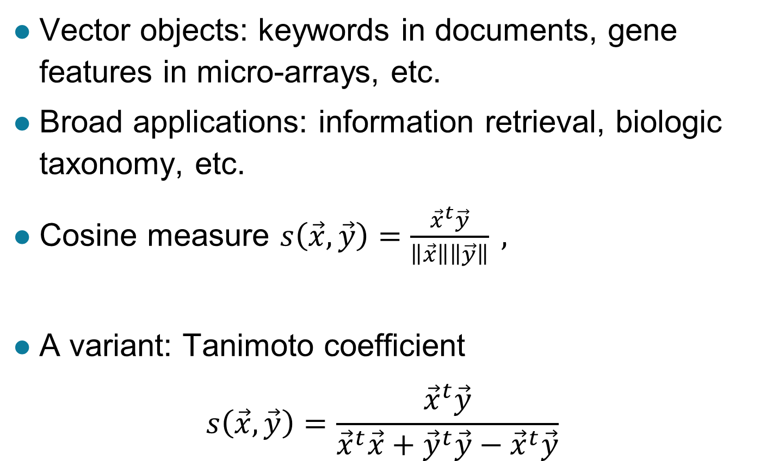
Vector Objects

Slide 21
Types of clusters

Slide 22
Types of Clusters
Well-separated clusters
Center-based clusters
Contiguous clusters
Density-based clusters
Property or Conceptual
Described by an Objective Function

Slide 23
Types of Clusters: Well-Separated
Well-Separated Clusters:
A cluster is a set of points such that any point in a cluster is closer (or more similar) to every other point in the cluster than to any point not in the cluster.
3 well-separated clusters

Slide 24
Types of Clusters: Center-Based
Center-based
A cluster is a set of objects such that an object in a cluster is closer (more similar) to the “center” of a cluster, than to the center of any other cluster
The center of a cluster is often a centroid, the average of all the points in the cluster, or a medoid, the most “representative” point of a cluster
4 center-based clusters

Slide 25
Types of Clusters: Contiguity-Based
Contiguous Cluster (Nearest neighbor or Transitive)
A cluster is a set of points such that a point in a cluster is closer (or more similar) to one or more other points in the cluster than to any point not in the cluster.
8 contiguous clusters

Slide 26
Types of Clusters: Density-Based
Density-based
A cluster is a dense region of points, which is separated by low-density regions, from other regions of high density.
Used when the clusters are irregular or intertwined, and when noise and outliers are present.
6 density-based clusters

Slide 27
Types of Clusters: Conceptual Clusters
Shared Property or Conceptual Clusters
Finds clusters that share some common property or represent a particular concept.
2 Overlapping Circles

Slide 28
Types of Clusters: Objective Function
Clusters Defined by an Objective Function
Finds clusters that minimize or maximize an objective function.
Enumerate all possible ways of dividing the points into clusters and evaluate the `goodness' of each potential set of clusters by using the given objective function. (NP Hard)
Can have global or local objectives.
Hierarchical clustering algorithms typically have local objectives
Partitional algorithms typically have global objectives

Slide 29
Types of Clusters: Objective Function …
Map the clustering problem to a different domain and solve a related problem in that domain
Proximity matrix defines a weighted graph, where the nodes are the points being clustered, and the weighted edges represent the proximities between points
Clustering is equivalent to breaking the graph into connected components, one for each cluster
Want to minimize the edge weight between clusters and maximize the edge weight within clusters

Slide 30
Clustering techniques

Slide 31
Types of Clustering
A clustering is a process to find a set of clusters
Important distinction between hierarchical and partitional sets of clusters
Partitional Clustering
A division data objects into non-overlapping subsets (clusters) such that each data object is in exactly one subset
Hierarchical clustering
A set of nested clusters organized as a hierarchical tree
Density based clustering
Discover clusters of arbitrary shape.
Clusters dense regions of objects separated by regions of low density

Slide 32
Partitional Clustering
Original Points
A Partitional Clustering

Slide 33
Hierarchical Clustering
Traditional Hierarchical Clustering
Traditional Dendrogram
Non-traditional Hierarchical Clustering
Non-traditional Dendrogram

Slide 34
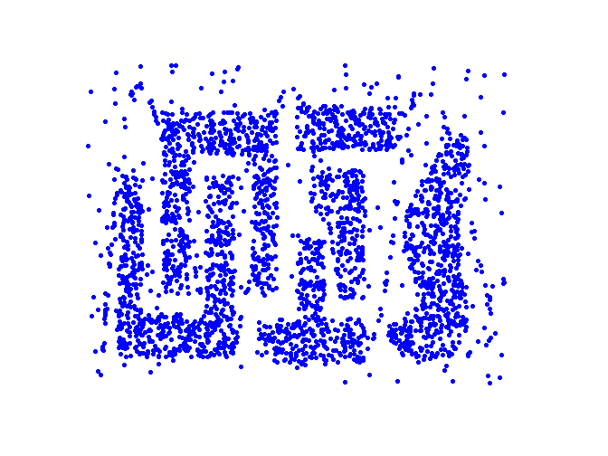
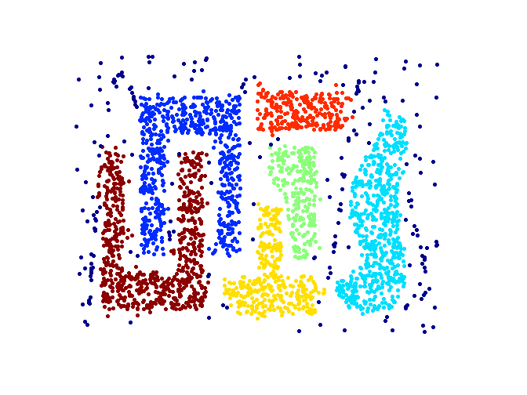
Density based Clustering
Original Points
Clusters

Slide 35
Clustering Algorithms
Partitional Clustering
Hierarchical clustering
Density-based clustering

Slide 36
Partitional Clustering

Slide 37
Partitional Clustering
Given
A data set of n objects
K the number of clusters to form
Organize the objects into k partitions (k<=n) where each partition represents a cluster
The clusters are formed to optimize an objective partitioning criterion
Objects within a cluster are similar
Objects of different clusters are dissimilar

Slide 38
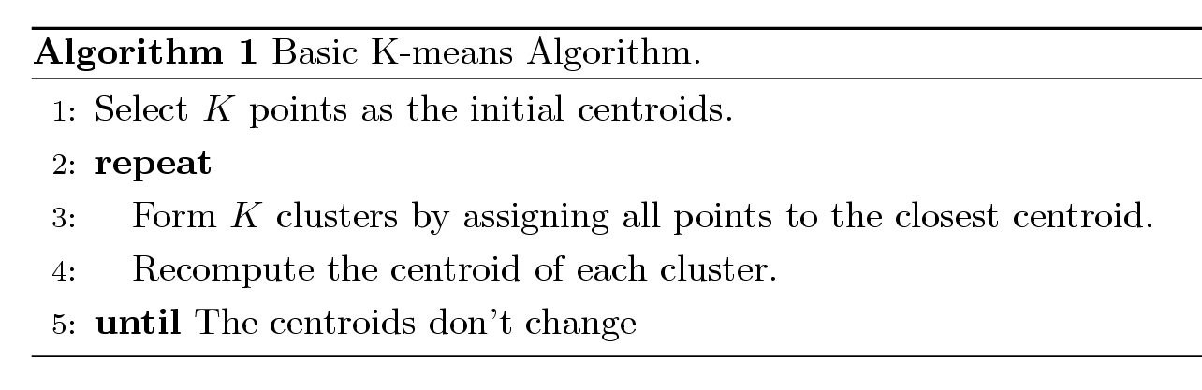
K-means Clustering
The basic algorithm is very simple
Number of clusters, K, must be specified
Each cluster is associated with a centroid (mean or center point)
Each point is assigned to the cluster with the closest centroid

Slide 39
K-means Clustering – Details
Initial centroids are often chosen randomly.
Clusters produced vary from one run to another.
The centroid is (typically) the mean of the points in the cluster.
‘Closeness’ is measured by Euclidean distance, cosine similarity, correlation, etc.
K-means will converge for common similarity measures mentioned above.
Most of the convergence happens in the first few iterations.
Often the stopping condition is changed to ‘Until relatively few points change clusters’ or some measure of clustering doesn’t change.
Complexity is O( n * K * I * d )
n = number of points, K = number of clusters, I = number of iterations, d = number of attributes

Slide 40
Evaluating K-means Clusters
Most common measure is Sum of Squared Error (SSE)
For each point, the error is the distance to the nearest cluster
To get SSE, we square these errors and sum them.
x is a data point in cluster C_{i} and m_{i} is the representative point for cluster C_{i}
can show that m_{i} corresponds to the center (mean) of the cluster
Given two clusters, we can choose the one with the smallest error
One easy way to reduce SSE is to increase K, i.e. the number of clusters
A good clustering with smaller K can have a lower SSE than a poor clustering with higher K

Slide 41


Two different K-means Clusterings
Original Points
Optimal Clustering
Sub-optimal Clustering

Slide 42
Importance of Choosing Initial Centroids (Case i)

Slide 43
Importance of Choosing Initial Centroids (Case i)

Slide 44
Importance of Choosing Initial Centroids (Case ii)

Slide 45
Importance of Choosing Initial Centroids (Case ii)

Slide 46
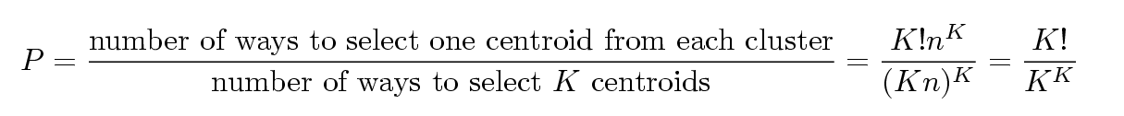
Problems with Selecting Initial Points
If there are K ‘real’ clusters then the chance of selecting one centroid from each cluster is small.
Chance is relatively small when K is large
If clusters are the same size, n, then
For example, if K = 10, then probability = 10!/10¹⁰ = 0.00036
Sometimes the initial centroids will readjust themselves in ‘right’ way, and sometimes they don’t
Consider an example of five pairs of clusters
Initial centers from different clusters may produce good clusters

Slide 47
10 Clusters Example (Good Clusters)
Starting with two initial centroids in one cluster of each pair of clusters

Slide 48
10 Clusters Example (Good Clusters)
Starting with two initial centroids in one cluster of each pair of clusters

Slide 49
10 Clusters Example (Bad Clusters)
Starting with some pairs of clusters having three initial centroids, while other have only one.

Slide 50
10 Clusters Example (Bad Clusters)
Starting with some pairs of clusters having three initial centroids, while other have only one.

Slide 51
Solutions to Initial Centroids Problem
Multiple runs
Helps, but probability is not on your side
Sample and use hierarchical clustering to determine initial centroids
Select more than k initial centroids and then select among these initial centroids
Select most widely separated
Post-processing
Bisecting K-means
Not as susceptible to initialization issues

Slide 52
Pre-processing and Post-processing
Pre-processing
Normalize the data
Eliminate outliers
Post-processing
Eliminate small clusters that may represent outliers
Split ‘loose’ clusters, i.e., clusters with relatively high SSE
Merge clusters that are ‘close’ and that have relatively low SSE
Can use these steps during the clustering process
ISODATA

Slide 53
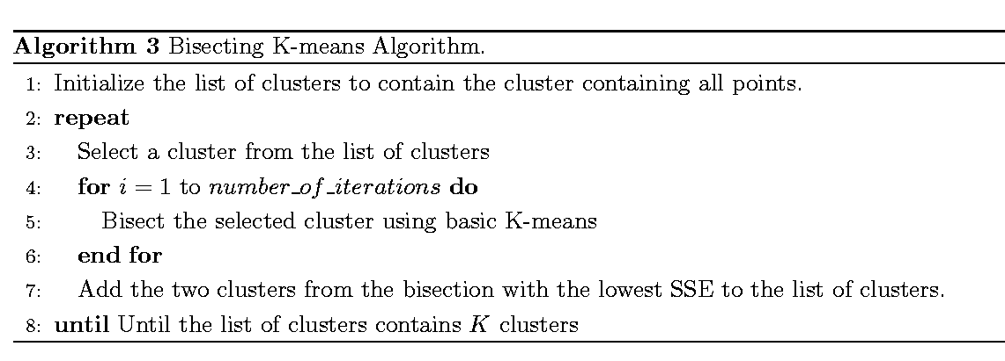
Bisecting K-means
Bisecting K-means algorithm
Variant of K-means that can produce a partitional or a hierarchical clustering

Slide 54
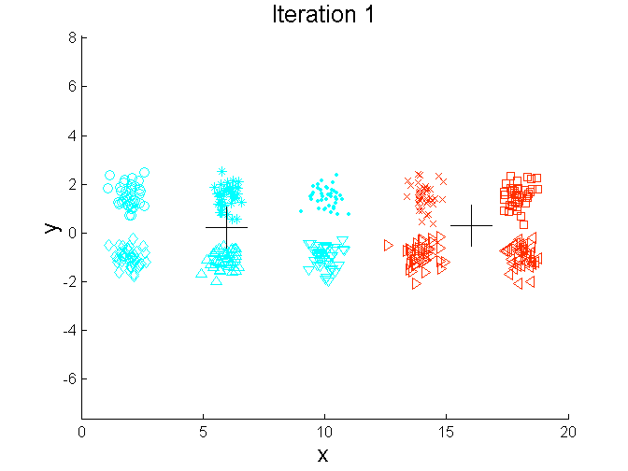
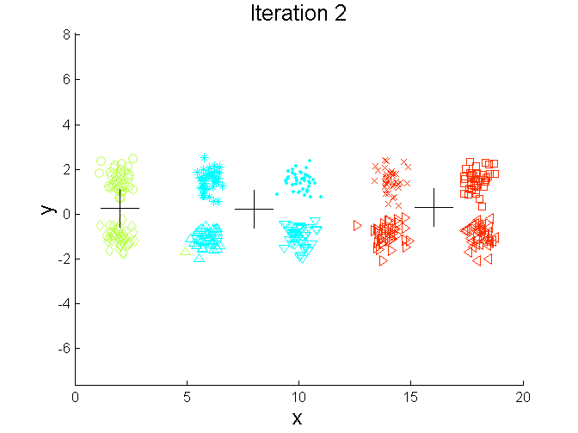
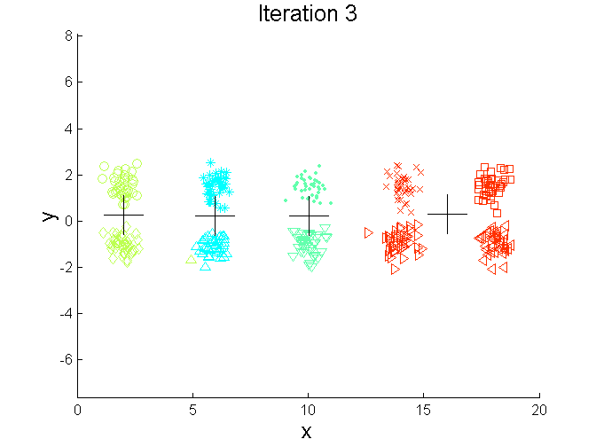
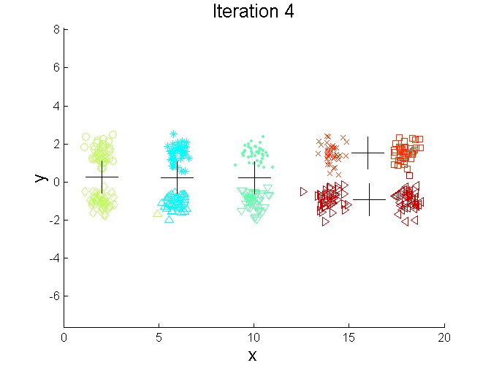
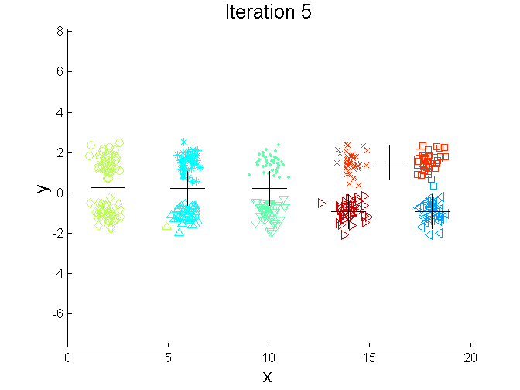
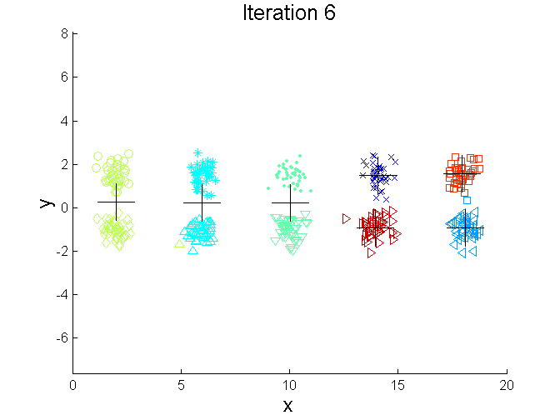
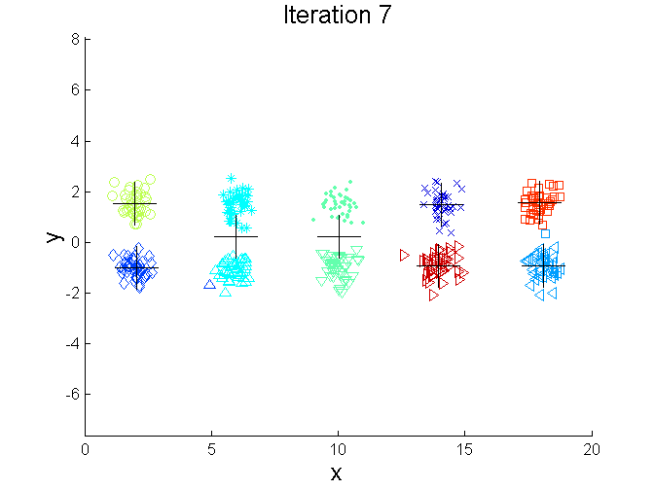
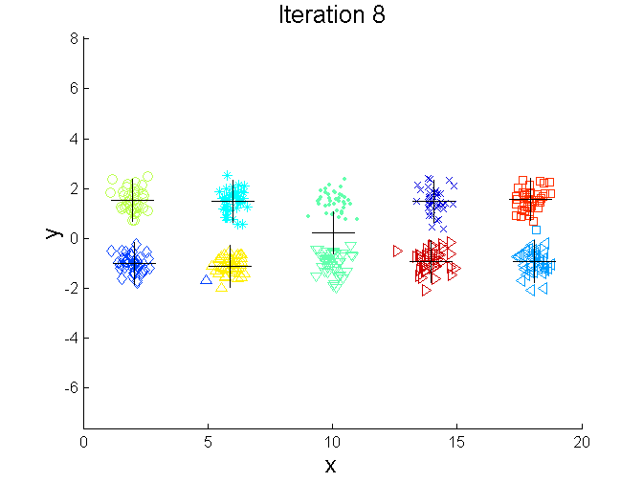
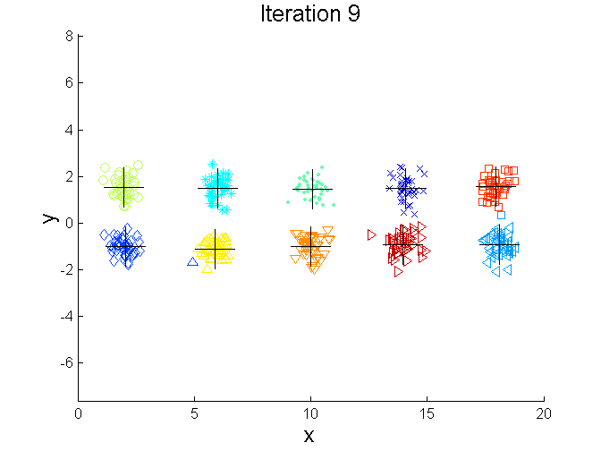
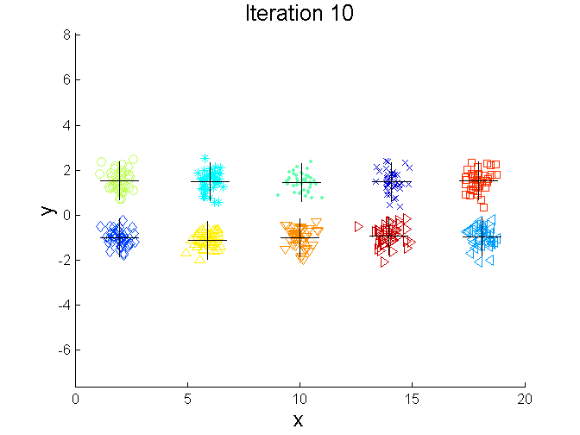
Bisecting K-means Example

Slide 55
Limitations of K-means
K-means has problems when clusters are of differing
Sizes
Densities
Non-globular shapes
K-means has problems when the data contains outliers.

Slide 56
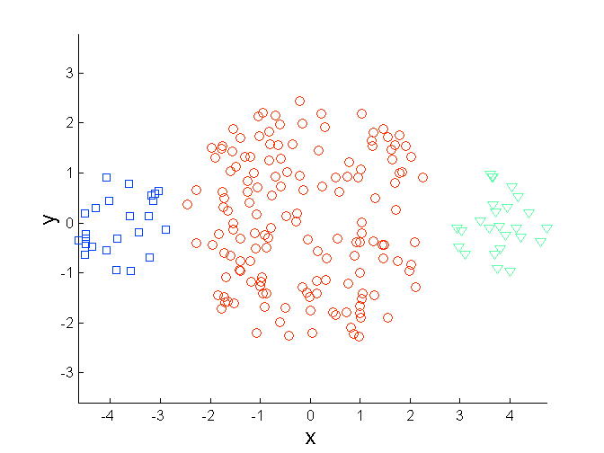
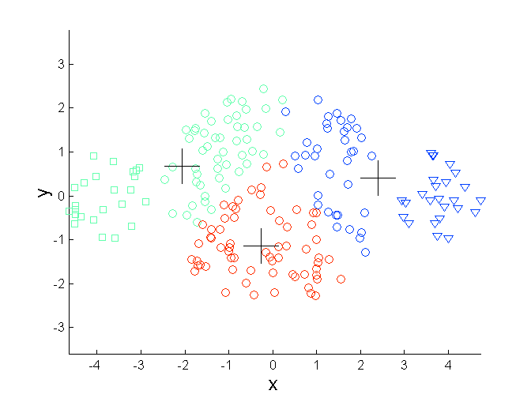
Limitations of K-means: Differing Sizes
Original Points
K-means (3 Clusters)

Slide 57
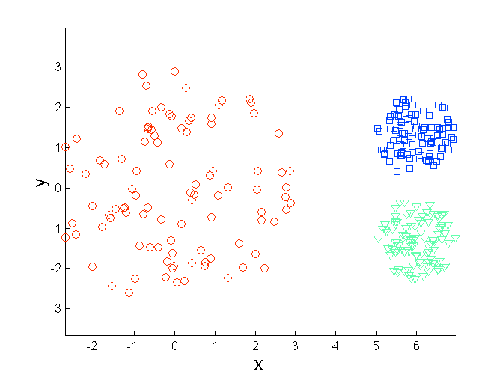
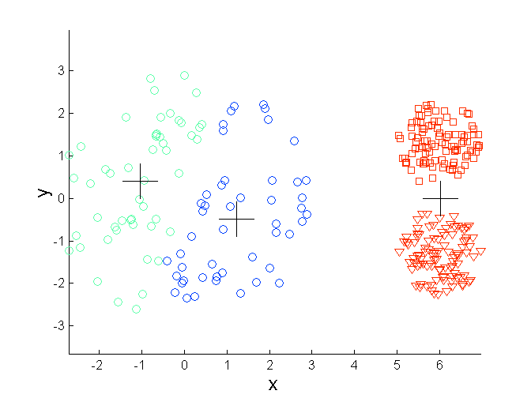
Limitations of K-means: Differing Density
Original Points
K-means (3 Clusters)

Slide 58
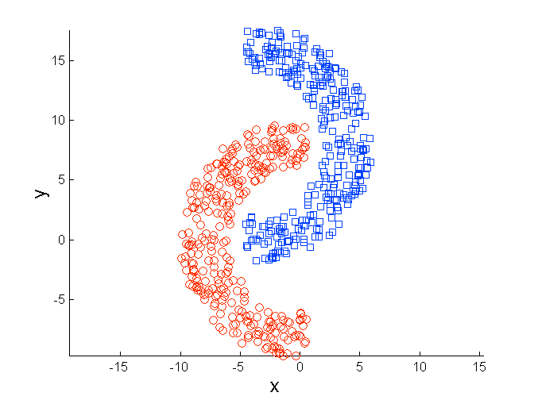
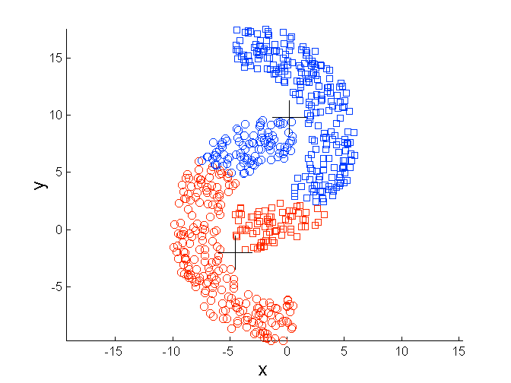
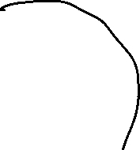

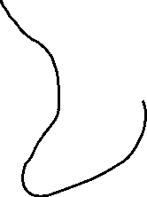


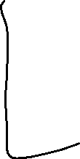

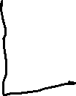
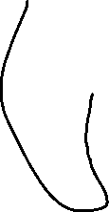
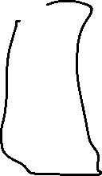
Limitations of K-means: Non-globular Shapes
Original Points
K-means (2 Clusters)

Slide 59








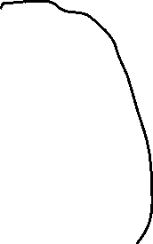









bv

Slide 60
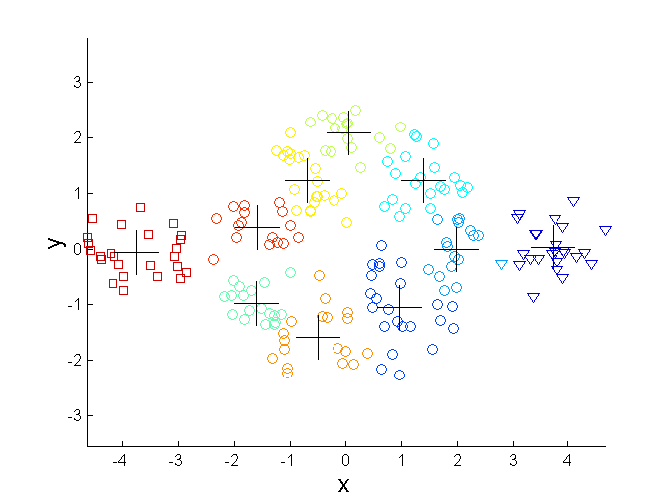
Overcoming K-means Limitations
Original Points K-means Clusters
One solution is to use many clusters.
Find parts of clusters, but need to put together.

Slide 61
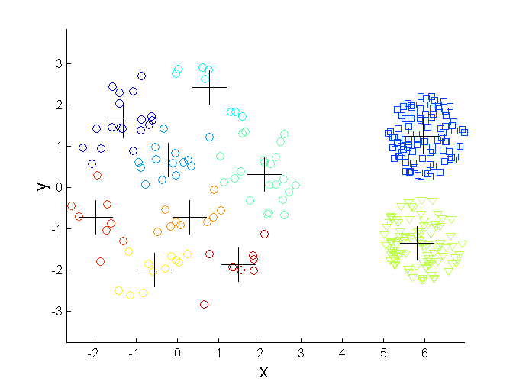
Overcoming K-means Limitations
Original Points K-means Clusters
One solution is to use many clusters.
Find parts of clusters, but need to put together.

Slide 62
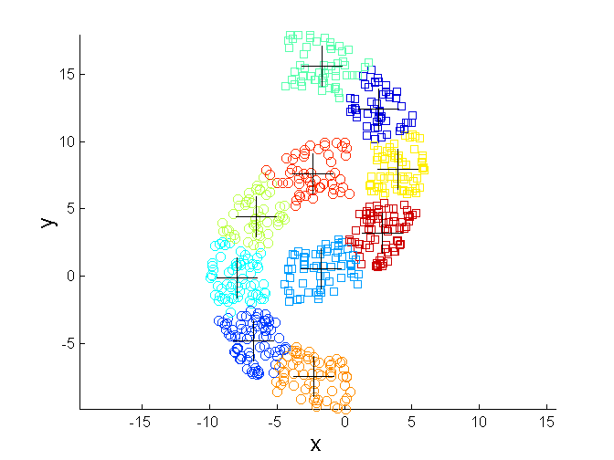
Overcoming K-means Limitations
Original Points K-means Clusters
One solution is to use many clusters.
Find parts of clusters, but need to put together.

Slide 63
Limitations of K-means: Outlier Problem
The k-means algorithm is sensitive to outliers !
Since an object with an extremely large value may substantially distort the distribution of the data.
Solution: Instead of taking the mean value of the object in a cluster as a reference point, medoids can be used, which is the most centrally located object in a cluster.
10
10
9
9
8
8
7
7
6
6
5
5
4
4
3
3
2
2
1
1
0
0
1
2
3
4
5
6
7
8
9
10
0
0
1
2
3
4
5
6
7
8
9
10

Slide 64
The K-Medoids Clustering Method
Find representative objects, called medoids, in clusters
PAM (Partitioning Around Medoids, 1987)
starts from an initial set of medoids and iteratively replaces one of the medoids by one of the non-medoids if it improves the total distance of the resulting clustering.
PAM works effectively for small data sets, but does not scale well for large data sets.
CLARA (Kaufmann & Rousseeuw, 1990)
CLARANS (Ng & Han, 1994): Randomized sampling

Slide 65
PAM (Partitioning Around Medoids)
Use real objects to represent the clusters (called medoids)
Select k representative objects arbitrarily
For each pair of selected object (i) and non-selected object (h), calculate the Total swapping Cost (TC_{ih})
For each pair of i and h,
If TC_{ih} < 0, i is replaced by h
Then assign each non-selected object to the most similar representative object
repeat steps 2-3 until there is no change in the medoids or in TC_{ih}.

Slide 66
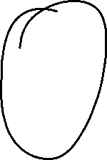



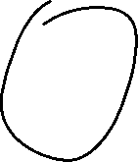
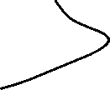




Slide 67
Total swapping Cost (TC_{ih})
Total swapping cost TC_{ih}=∑_{j}C_{jih}
Where C_{jih} is the cost of swapping i with h for all non medoid objects j
C_{jih} will vary depending upon different cases

Slide 68

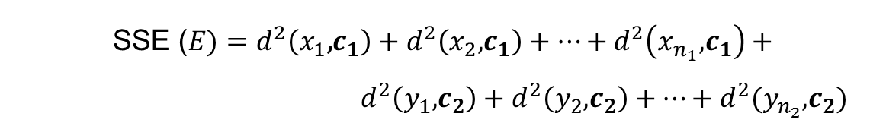






Sum of Squared Error (SSE)
$$\text{SSE} \text{(}E)=\sum_{i=1}^{k}{\sum_{j∈C_{i}}{d2(j,i)}}$$
$$y_{3}$$
$$x_{2}$$
$$y_{2}$$
$$x_{3}$$
$$x_{1}$$
C₂
$$y_{1}$$
C₁
$$\text{SSE} \text{(}E)=d^{2}\left(x_{1}\text{,}c_{1}\right)+d^{2}\left(x_{2}\text{,}c_{1}\right)+…+d^{2}\left(x_{n_{1}}\text{,}c_{1}\right)+$$
${ d}^{2}\left(y_{1}\text{,}c_{2}\right)+d^{2}\left(y_{2}\text{,}c_{2}\right)+…+d^{2}(y_{n_{2}}\text{,}c_{2})$

Slide 69

Case (i) : Computation of C_{jih}
j currently belongs to the cluster represent by the medoid i
j is less similar to the medoid t compare to h
t
Therefore, in future, j belongs to the cluster represented by h
j
h
i
$$E=\sum_{i=1}^{k}{\sum_{j∈C_{i}}{d(j,i)}}$$

Slide 70






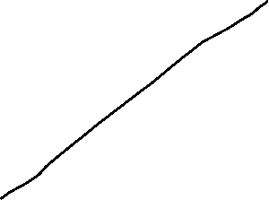








Slide 71
Case (ii) : Computation of C_{jih}
j currently belongs to the cluster represent by the medoid i
j is more similar to the medoid t compare to h
h
Therefore, in future, j belongs to the cluster represented by t
j
i
t

Slide 72
Case (iii) : Computation of C_{jih}
j currently belongs to the cluster represent by the medoid t
j is more similar to the medoid t compare to h
t
j
Therefore, in future, j belongs to the cluster represented by t itself
h
i

Slide 73
Case (iv) : Computation of C_{jih}
j currently belongs to the cluster represent by the medoid t
j is less similar to the medoid t compare to h
t
Therefore, in future, j belongs to the cluster represented by h
j
h
i

Slide 74
PAM Clustering:
i
h
j
t

Slide 75
PAM or K-Medoids: Example
Data Objects
9
8
7
6
5
4
3
A1
2
3
3
4
6
6
7
7
8
7
A2
6
4
8
7
2
4
3
4
5
6
4
01
0₂
0₃
0₄
0₅
0₆
0₇
0₈
0₉
⁰10
1
10
9
2
6
8
3
7
5
2
8
3
4
5
6
7
9
Goal: create
two clusters
Choose randmly two medoids
08 = (7,4) and 02 = (3,4)

Slide 76
PAM or K-Medoids: Example
Data Objects
9
8
7
6
5
4
_{cluster1}
3
cluster2
A1
2
3
3
4
6
6
7
7
8
7
A2
6
4
8
7
2
4
3
4
5
6
4
01
0₂
0₃
0₄
0₅
0₆
0₇
0₈
0₉
⁰10
1
10
9
2
6
8
3
7
5
2
8
3
4
5
6
7
9
Assign each
object to the
closest representative object
Using L1 Metric (Manhattan), we form the following clusters
Cluster1 = {0₁, 0₂, 0₃, 0₄}
Cluster2 = {05, 06, 07, 08, 09, 010}

Slide 77

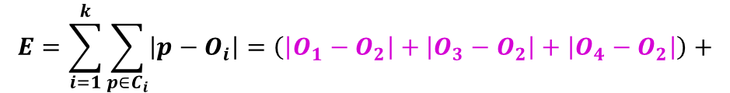



PAM or K-Medoids: Example
Data Objects
9
8
7
6
5
4
_{cluster1}
3
cluster2
A1
2
3
3
4
6
6
7
7
8
7
A2
6
4
8
7
2
4
3
4
5
6
4
01
0₂
0₃
0₄
0₅
0₆
0₇
0₈
0₉
⁰10
1
10
9
2
6
8
3
7
5
2
8
3
4
5
6
7
9
Compute the absolute error criterion [for the set of Medoids (O2,O8)]
$$E=\sum_{i=1}^{k}{\sum_{p∈C_{i}}{\left|p−O_{i}\right|=\left(\left|O_{1}−O_{2}\right|+\left|O_{3}−O_{2}\right|+\left|O_{4}−O_{2}\right|\right)+}}$$
$$\left(\left|O_{5}−O_{8}\right|+\left|O_{6}−O_{8}\right|+\left|O_{7}−O_{8}\right|+\left|O_{9}−O_{8}\right|+\left|O_{10}−O_{8}\right|\right)$$

Slide 78
PAM or K-Medoids: Example
Data Objects
9
8
7
6
5
4
_{cluster1}
3
cluster2
A1
2
3
3
4
6
6
7
7
8
7
A2
6
4
8
7
2
4
3
4
5
6
4
01
0₂
0₃
0₄
0₅
0₆
0₇
0₈
0₉
⁰10
1
10
9
2
6
8
3
7
5
2
8
3
4
5
6
7
9
The absolute error criterion [for the set of Medoids (O₂,O₈)]
E = (3+4+4)+(3+1+1+2+2) = 20

Slide 79
PAM or K-Medoids: Example
Data Objects
9
8
7
6
5
4
_{cluster1}
3
cluster2
A1
2
3
3
4
6
6
7
7
8
7
A2
6
4
8
7
2
4
3
4
5
6
4
01
0₂
0₃
0₄
0₅
0₆
0₇
0₈
0₉
⁰10
1
10
9
2
6
8
3
7
5
2
8
3
4
5
6
7
9
Choose a random object 0₇
Swap 0₈ and 0₇
Compute the absolute error criterion [for the set of Medoids (0₂,0₇)
E = (3+4+4)+(2+2+1+3+3) = 22

Slide 80
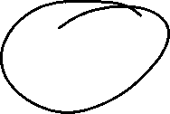
PAM or K-Medoids: Example
Data Objects
9
8
7
6
5
4
_{cluster1}
3
cluster2
A1
2
3
3
4
6
6
7
7
8
7
A2
6
4
8
7
2
4
3
4
5
6
4
01
0₂
0₃
0₄
0₅
0₆
0₇
0₈
0₉
⁰10
1
10
9
2
6
8
3
7
5
2
8
3
4
5
6
7
9
Compute the cost function
Absolute error [0₂ ,0₇ ] - Absolute error [for 0₂ ,0₈ ]
S=22-20
S> 0 => It is a bad idea to replace 0₈ by 0₇

Slide 81







PAM or K-Medoids: Example
Data Objects
9
8
7
6
5
4
_{cluster1}
3
cluster2
A1
2
3
3
4
6
6
7
7
8
7
A2
6
4
8
7
2
4
3
4
5
6
4
01
0₂
0₃
0₄
0₅
0₆
0₇
0₈
0₉
⁰10
1
10
9
2
6
8
3
7
5
2
8
3
4
5
6
7
9
C₆₈₇ = d(0₇,0₆) - d(0₈,0₆)=2-1=1
C₅₈₇ = d(0₇,0₅) - d(0₈,0₅)=2-3=-1
C₉₈₇ = d(0₇,0₉) - d(0₈,0₉)=3-2=1
C₁₀₈₇ = d(0₇,0₁₀) - d(0₈,0₁₀)=3-2=1
C₁₈₇=0, C₃₈₇=0, C₄₈₇=0
TC_{ih}=∑_{j}C_{jih}=1-1+1+1=2=S

Slide 82

PAM or K-Medoids : Different View
Initial Medoids
{0₃,0₂}
E=20
Dataset=$\left\{0_{1},0_{2},0_{3},0_{4},0_{5}\right\}$
No. of patterns (n) = 5
No. of clusters (k) =2

Slide 83


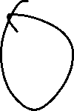




Slide 84
PAM or K-Medoids : Different View
Initial Medoids
{0₃,0₂}
E=20
Dataset=$\left\{0_{1},0_{2},0_{3},0_{4},0_{5}\right\}$
No. of patterns (n) = 5
No. of clusters (k) =2
{0₃,0₁}
E=30
{0₃,0₄}
E=10
{0₃,0₅}
E=12
{0₁,0₂}
E=19
{0₄,0₂}
E=33
{0₅,0₂}
E=14

Slide 85
PAM or K-Medoids : Different View
Initial Medoids
{0₃,0₂}
E=20
Dataset=$\left\{0_{1},0_{2},0_{3},0_{4},0_{5}\right\}$
No. of patterns (n) = 5
No. of clusters (k) =2
{0₃,0₁}
E=30
{0₃,0₄}
E=10
{0₃,0₅}
E=12
{0₁,0₂}
E=19
{0₄,0₂}
E=33
{0₅,0₂}
E=14

Slide 86
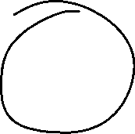
PAM or K-Medoids : Different View
Initial Medoids
{0₃,0₂}
E=20
Dataset=$\left\{0_{1},0_{2},0_{3},0_{4},0_{5}\right\}$
No. of patterns (n) = 5
No. of clusters (k) =2
{0₃,0₁}
E=30
{0₃,0₄}
E=10
{0₃,0₅}
E=12
{0₁,0₂}
E=19
{0₄,0₂}
E=33
{0₅,0₂}
E=14
{0₁,0₄}
E=26
{0₁,0₅}
E=17
{0₄,0₅}
E=9

Slide 87
PAM or K-Medoids : Different View
Initial Medoids
{0₃,0₂}
E=20
Dataset=$\left\{0_{1},0_{2},0_{3},0_{4},0_{5}\right\}$
No. of patterns (n) = 5
No. of clusters (k) =2
{0₃,0₁}
E=30
{0₃,0₄}
E=10
{0₃,0₅}
E=12
{0₁,0₂}
E=19
{0₄,0₂}
E=33
{0₅,0₂}
E=14
{0₁,0₄}
E=26
{0₁,0₅}
E=17
{0₄,0₅}
E=9

Slide 88

PAM or K-Medoids : Different View
Initial Medoids
{0₃,0₂}
E=20
Dataset=$\left\{0_{1},0_{2},0_{3},0_{4},0_{5}\right\}$
No. of patterns (n) = 5
No. of clusters (k) =2
{0₃,0₁}
E=30
{0₃,0₄}
E=10
{0₃,0₅}
E=12
{0₁,0₂}
E=19
{0₄,0₂}
E=33
{0₅,0₂}
E=14
{0₁,0₄}
E=26
{0₁,0₅}
E=17
{0₄,0₅}
E=9

Slide 89
PAM or K-Medoids : Different View
Initial Medoids
{0₃,0₂}
E=20
Dataset=$\left\{0_{1},0_{2},0_{3},0_{4},0_{5}\right\}$
No. of patterns (n) = 5
No. of clusters (k) =2
{0₃,0₁}
E=30
{0₃,0₄}
E=10
{0₃,0₅}
E=12
{0₁,0₂}
E=19
{0₄,0₂}
E=33
{0₅,0₂}
E=14
{0₁,0₄}
E=26
{0₁,0₅}
E=17
{0₄,0₅}
E=9

Slide 90
PAM or K-Medoids : Different View
Initial Medoids
{0₃,0₂}
E=20
Dataset=$\left\{0_{1},0_{2},0_{3},0_{4},0_{5}\right\}$
No. of patterns (n) = 5
No. of clusters (k) =2
{0₃,0₁}
E=30
{0₃,0₄}
E=10
{0₃,0₅}
E=12
{0₁,0₂}
E=19
{0₄,0₂}
E=33
{0₅,0₂}
E=14
{0₁,0₄}
E=26
{0₁,0₅}
E=17
{0₄,0₅}
E=9

Slide 91
PAM or K-Medoids : Different View
Total possibilities for a node=2*3=k*(n-k)
Cost to compute E= (n-k)
Total cost for each node is = k*(n-k)²
Goal is to search in the graph for a node with minimum cost

Slide 92
What Is the Problem with PAM?
PAM is more robust than k-means in the presence of noise and outliers because a medoid is less influenced by outliers or other extreme values than a mean.
PAM works efficiently for small data sets but does not scale well for large data sets.
O(k(n-k)² ) for each iteration; where n is # of data, k is # of clusters.
Sampling based method, CLARA (Clustering LARge Applications)

Slide 93
CLARA (Clustering Large Applications)
CLARA (Kaufmann and Rousseeuw in 1990)
It draws multiple samples of the data set, applies PAM on each sample, and gives the best clustering as the output.
Strength: deals with larger data sets than PAM.
Weakness:
Efficiency depends on the sample size.
A good clustering based on samples will not necessarily represent a good clustering of the whole data set if the sample is biased.

Slide 94
CLARA (Clustering Large Applications)
CLARA draws a sample of the dataset and applies PAM on the sample in order to find the medoids.
If the sample is best representative of the entire dataset then the medoids of the sample should approximate the medoids of the entire dataset.
Medoids are chosen from the sample.
Note that the algorithm cannot find the best solution if one of the best k-medoids is not among the selected sample.

Slide 95
CLARA (Clustering Large Applications)
PAM
sample

Slide 96
CLARA (Clustering Large Applications)
Choose the best clustering
To improve the approximation, multiplesamples are drawn and the best clustering is returned as the output.
The clustering accuracy is measured by the average dissimilarity of all objects in the entire dataset.
Experiments show that 5 samples of size 40+2k give satisfactory results
Clusters
Clusters
Clusters
PAM
PAM
PAM
…
sample1
sample2
samplem

Slide 97
CLARA (Clustering Large Applications)
For i= 1 to 5, repeat the following steps
Draw a sample of 40 + 2k objects randomly from the entire data set, and call Al-gorithm PAM to find k medoids of the sample.
For each object in the entire data set, determine which of the k medoids is the most similar to it.
Calculate the average dissimilarity ON THE ENTIRE DATASET of the clustering obtained in the previous step. If this value is less than the current minimum, use this value as the current minimum, and retain the k medoids found in Step (1) as the best set of medoids obtained so far.

Slide 98
CLARA (Clustering Large Applications)
Complexity of each Iteration is: 0(k(40+k)² + k(n-k))
s: the size of the sample
k: number of clusters
n: number of objects
PAM finds the best k medoids among a given data, and CLARA finds the best k medoids among the selected samples.
Problems
The best k medoids may not be selected during the sampling process, in this case, CLARA will never find the best clustering.
If the sampling is biased we cannot have a good clustering.

Slide 99

PAM or K-Medoids : Different View
{0₂,0₃}
E=20
Dataset=$\left\{0_{1},0_{2},0_{3},0_{4},0_{5}\right\}$
Initial Medoids
No. of patterns (n) = 5
No. of clusters (k) =2
{0₃,0₁}
E=30
{0₃,0₄}
E=10
{0₃,0₅}
E=12
{0₁,0₂}
E=19
{0₄,0₂}
E=33
{0₅,0₂}
E=14
{0₁,0₄}
E=26
{0₁,0₅}
E=17
{0₄,0₅}
E=21

Slide 100
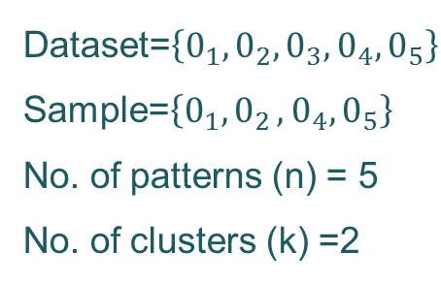
CLARA: Different View
Dataset=$\left\{0_{1},0_{2},0_{3},0_{4},0_{5}\right\}$
Sample=$\left\{0_{1}{, 0}_{2},0_{4},0_{5}\right\}$
No. of patterns (n) = 5
No. of clusters (k) =2
Initial Medoids
{0₂,0₄}
E=20
{0₁,0₄}
E=12
{0₅,0₄}
E=30
{0₂,0₁}
E=19
{0₂,0₅}
E=10
{0₁,0₅}
E=17
This graph is a sub-graph of PAM graph.

Slide 101
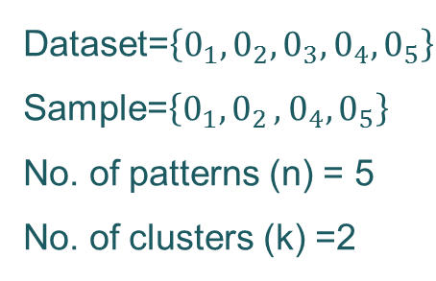
CLARA: Different View
This graph is a sub-graph of the PAM graph.
Initial Medoids
Dataset=$\left\{0_{1},0_{2},0_{3},0_{4},0_{5}\right\}$
Sample=$\left\{0_{1}{, 0}_{2},0_{4},0_{5}\right\}$
No. of patterns (n) = 5
No. of clusters (k) =2
{0₁,0₂}
E=19
{0₄,0₂}
E=33
{0₅,0₂}
E=14
{0₁,0₄}
E=26
{0₁,0₅}
E=17
{0₄,0₅}
E=21

Slide 102
CLARA: Different View
{0₂,0₃}
E=20
Dataset=$\left\{0_{1},0_{2},0_{3},0_{4},0_{5}\right\}$
Sample=$\left\{0_{1}{, 0}_{2},0_{4},0_{5}\right\}$
No. of patterns (n) = 5
No. of clusters (k) =2
Initial Medoids
{0₃,0₁}
E=30
{0₃,0₄}
E=10
{0₃,0₅}
E=12
{0₁,0₂}
E=19
{0₄,0₂}
E=33
{0₅,0₂}
E=14
{0₁,0₄}
E=26
{0₁,0₅}
E=17
{0₄,0₅}
E=21

Slide 103
CLARANS (“Randomized” CLARA)
CLARANS (A Clustering Algorithm based on Randomized Search) (Ng and Han’94).
CLARANS draws sample of neighbors dynamically.
The clustering process can be presented as searching a graph where every node is a potential solution, that is, a set of k medoids.
If the local optimum is found, CLARANS starts with new randomly selected node in search for a new local optimum.
It is more efficient and scalable than both PAM and CLARA.
Focusing techniques and spatial access structures may further improve its performance (Ester et al.’95).

Slide 104
CLARA: Different View
This graph is a sub-graph of the PAM graph.
Initial Medoids
Dataset=$\left\{0_{1},0_{2},0_{3},0_{4},0_{5}\right\}$
Sample=$\left\{0_{1}{, 0}_{2},0_{4},0_{5}\right\}$
No. of patterns (n) = 5
No. of clusters (k) =2
{0₁,0₂}
E=19
{0₄,0₂}
E=33
{0₅,0₂}
E=14
{0₁,0₄}
E=26
{0₁,0₅}
E=17
{0₄,0₅}
E=9

Slide 105
CLARA: Different View
{0₂,0₃}
E=20
Dataset=$\left\{0_{1},0_{2},0_{3},0_{4},0_{5}\right\}$
Sample=$\left\{0_{1}{, 0}_{2},0_{4},0_{5}\right\}$
No. of patterns (n) = 5
No. of clusters (k) =2
Initial Medoids
{0₃,0₁}
E=30
{0₃,0₄}
E=10
{0₃,0₅}
E=12
{0₁,0₂}
E=19
{0₄,0₂}
E=33
{0₅,0₂}
E=14
{0₁,0₄}
E=26
{0₁,0₅}
E=17
{0₄,0₅}
E=9

Slide 106
CLARANS
Does not confine the search to a localized area
Stops the search when a local minimum is found
Finds several local optimums and output the clustering with the best local optimum
Goal is to search in the graph for a node with minimum cost

Slide 107
CLARANS Properties
Advantages
Experiments show that CLARANS is more effective than both PAM and CLARA
Handles outliers
Disadvantages
The computational complexity of CLARANS is O(n²), where n is the number of objects
The clustering quality depends on the sampling method

